Slide 1
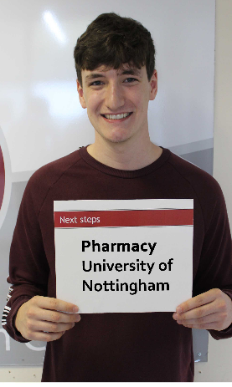
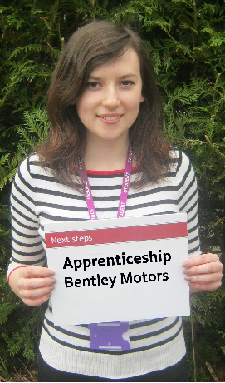
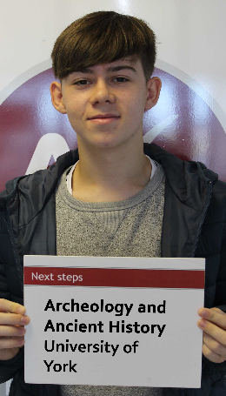
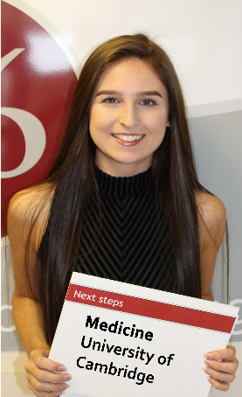
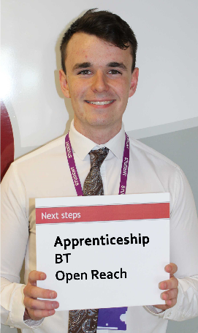
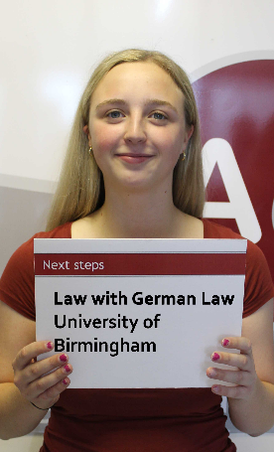
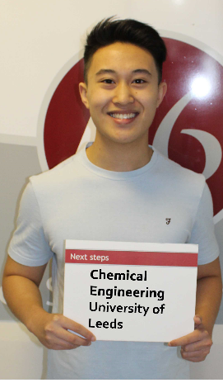
Transition information Year 12 Parents
Andrew Evans
Deputy Director Sixth Form

Slide 2
A levels, BTEC’s, CTEC’s and GCSE resits
All A levels are two year course
No external AS exams
Our internal progression exams need to be passed at
E or above
BTEC’s have on line exams
EG Applied Science (each unit needs to be passed)
Yr 12 Certificate (3 units)
Yr 13 Extended certificate (3 units)
GCSE Maths and English resits 4 periods per fortnight

Slide 3
Provision through our two week timetable
Ten one hour periods per fortnight per subject
Nine independent learning sessions
Form period everyday
Two one hour periods every Wednesday period 1 devoted to VESPA and PHSE
Students at school from 8.40 to 3.10
Termly focus
Autumn Ambition (aim high)
Spring Challenge (belonging and contributing to our community)
Summer Volunteering (charity work and fund raising)

Slide 4
VESPA coaching with tutor
Vision:
Effort:
Systems:
Practice
Attitude:
How well do you know what you want to achieve
What will you have to do to realise your vision?
How do you organise your learning and mange your time?
What kind of work do you do to practice and apply your skills?
How do you respond to setbacks?

Slide 5
Keeping everyone informed
Window Opens | Window Closes | To Parents
Settling in grade | KS5 | Yr12 | 27/09/21 | 01/10/21 | 06/10/21
AP1 | KS5 | Yr12 | 16/11/21 | 23/11/21 | 01/12/21
Year 12 Parents Evening | Thursday | 9/12/21 | 4.15-7.00pm
AP2 | KS5 | Yr12 | 08/03/22 | 11/03/22 | 16/03/22
AP3 | KS5 | Yr 12 | 13/05/22 | 20/05/22 | 26/05/22
GCSE early resit 9th to 13th Nov 21
GCSE resit results 07/01/22
Year 12 exams 21/4/22 to 29/4/22
Resit week 06/6/22 to 09/6/22

Slide 6
Settling in grade 6th October
Settling In Grade
1: Settled in well and no issues
2: Settled in but problems with deadlines
3: Settled in but problems with attitude
4: Not settled in due a combination of attitude, meeting deadlines or poor attendance
1
1
2

Slide 7
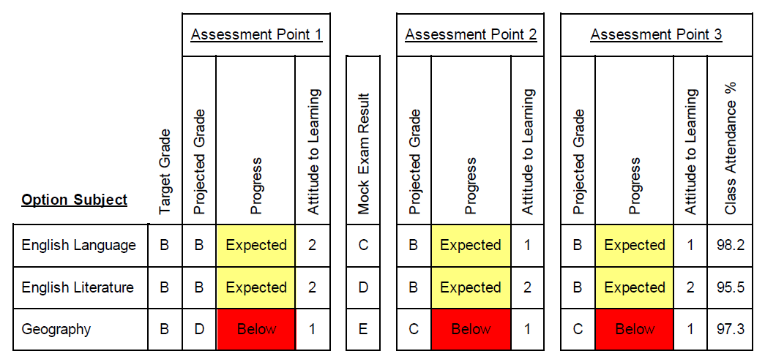
Assessment
GCSE Score A2 Target grade
Mainly 9’s and 8’s Target grade A*/A
Mainly 8’s and 7’s, Target grade A/B
Mainly 7’s and 6’s Target grade B/C
Mainly 5’s and 4’s Target grade C/D
Settling in grade 6/10/21
Three assessment points
AP1 1st December
AP2 16th March
AP3 26th May
Parents evening
Thursday 9/12/21
Reports sent
home
Year 12 exams
GCSE resits 9th to 13th Nov
Internal progression
exams start
21st April to 29^{h} April
Resits
6th to 9th June
Allows time for
alternate pathways
or course change

Slide 8
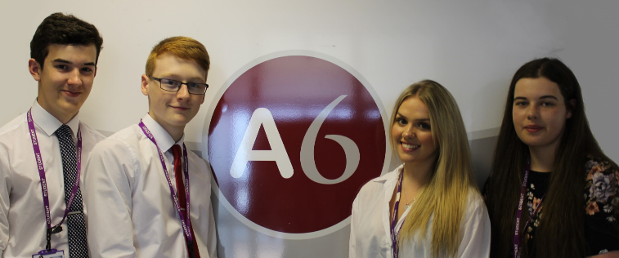
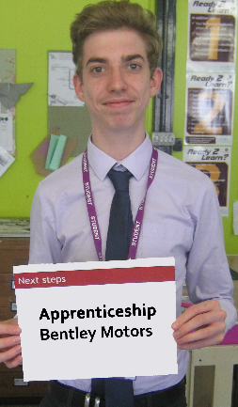
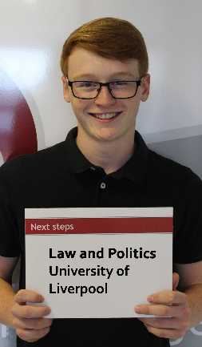
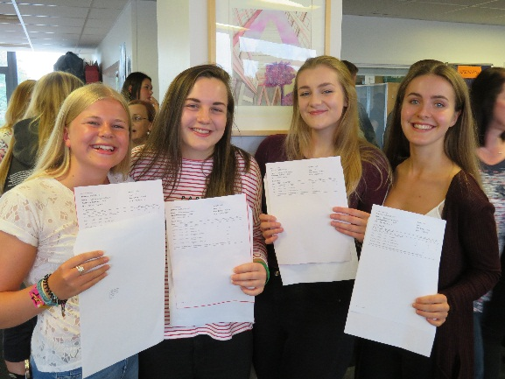
Successful Students
Attendance 95% plus
Punctuality
Follow the dress code
All above are reported on to you
and follow on from Year 11 (same rules apply)
Do homework
Work in non contacts
Show commitment
Organised
Read around the subject
(books, journals, web articles)
Positive member of the school
and wider community
8.40 to 3.10

Slide 9
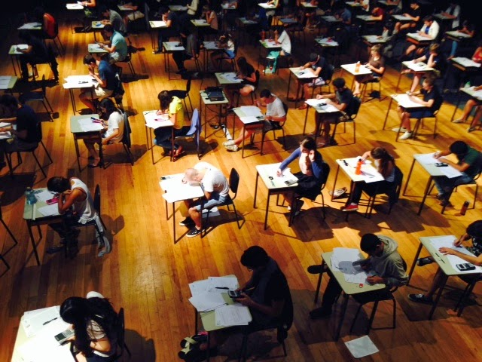
Internal progression exams and work placement
All A level subjects set exams for 21st to 29th April 2022
Results sent home 26th May 2022
Resits week beginning 6th June 2022
GCSE resits begin 9th November 2021
Results 7th January 2022
Traineeships receive up to two work placements
(dependent upon Covid regulations) that
last eighteen weeks and end after one year.
Focus on securing an Apprenticeship, enter year 12
or secure College placement
All employers send reports directly to school

Slide 10
Intervention and support
Students off target in one subject receive support from subject staff.
Extra sessions of independent learning sessions
Wider reading given
New work set
Students off target in multiple subjects
As above and work in enrichment sessions as well
timetabled in extra classes

Slide 11
Good use of time?

Slide 12
Careers
Student connections Mrs Casewell
Twitter feed for apprenticeships
Careers interview
GMEX Apprenticeship fair
Work placements
UCAS University day
University open days
Oxbridge conference
Parents evening

Slide 13
New UCAS points
A level | New Tariff points For A level Yr 13 completion | BTEC Subsidiary Diploma or AQA Applied extended certificate Year 13 completion | BTEC Certificate or AQA Applied certificate Year 12 completion
A* | 56 | D*
A | 48 | D
B | 40
C | 32 | M
 | 28 |  | D*
D | 24 |  | D
E | 16 | P | M
 | 8 |  | P
An example of a typical University offer
UCAS Tariff | 112 points
A level | BBC
Lincoln University Architecture
Qualification requirements

Slide 14
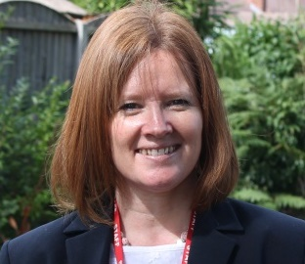
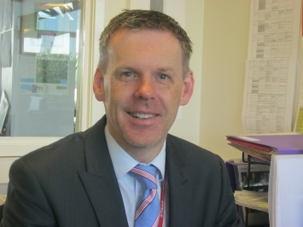
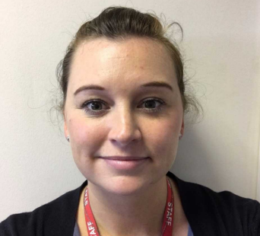
Contacts or questions
Our team
Mrs Pole Head of Sixth Form
Mr Evans Deputy Head of Sixth Form
Mrs Pass Student attendance
a.evans@alsagerschool.org
sixthform@alsagerschool.org
O1270871122
Many thanks for your continued support.

