Slide 1
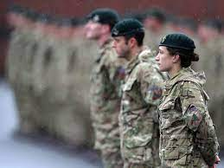
A comprehensive Sixth Form

Slide 2
AIMS OF THIS PRESENTATION
Year 13 Key Dates
Year 13 Issues
Sixth Form Culture
How we support you

Slide 3
Key Dates: Autumn Term
1st September UCAS applications available online
During September 1st draft personal statements discussed with form tutors.
Friday 17th September For Oxbridge, Medics, Vets, Dentistry completed UCAS forms to be sent to the administrator.
15th October Closing date for UCAS forms for Oxbridge, Medics, Vets, Dentistry. BMAT, LNAT, HAT applications
11 October – 22nd October – Year 13 Mocks (1)
9 November – 16 November – AP1
24th November Assessment point 1 grades home to parents
23rd October Completed UCAS forms to be sent to the administrator for addition of references.
2nd December – Parents Evening
Students will need to check for your university course if there are additional entry requirements or tests and arrange via the 6th form office to be entered for them. The closing date for most tests is 15 October

Slide 4
Important Information About Entrance Tests and Early Entry Courses
15th October Closing date for UCAS forms for Oxbridge, Medics, Vets, Dentistry. BMAT, LNAT, HAT applications
Students must check whether their course requires and additional test and see the exams officer Mrs Hartas to arrange to be entered as soon as possible. They cannot be entered for the tests after 15 October. It is possible that some tests will take place in the half term and school will be opened to accommodate that.

Slide 5
The UCAS Process at Alsager School
1. Student fills out UCAS form on UCAS online and completes personal statement in a word document
2. When making choices students need to make sure they match the UCAS projected grades. Students need a range of courses - aspirational, realistic and back up. The maximum number of choices is 5
3. Student asks form tutor to check personal statement. Don't show it to more than two people or it will have too many conflicting suggestions.
4. Once the personal statement has been checked students can upload it to their UCAS form and press pay and send - this does not send the form to UCAS - just to the administrator (Mrs Pole).
5. Students should then ask their tutor to write their reference.
6. Tutor writes reference and sends it to Mrs Pole for checking. We then send the form with the reference attached to UCAS - no changes can be made after this point.

Slide 6
Key Dates: Spring Term
26th January UCAS deadline for receipt of applications
17th January – 28th January – Mocks (2)
8th February – 15th February – AP2
February Student Finance application window opens
28th February Assessment point 2 grades home to parents
March UCAS Extra available for students who are holding no offers
March Many apprenticeship application windows open
14th -18th March – Mocks (3)
20th March – 20th April – AP3
27th April - Assessment Point 3 grades home to parents

Slide 7
Key Dates:Summer Term
April: Start applying for university accommodation
3rd May: Deadline for accepting university offers
Further dates TBC

Slide 8
Make The Right Choices

Slide 9
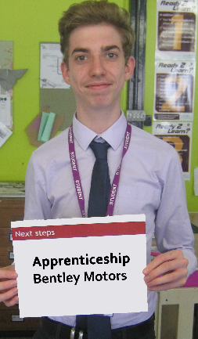
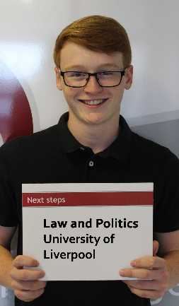
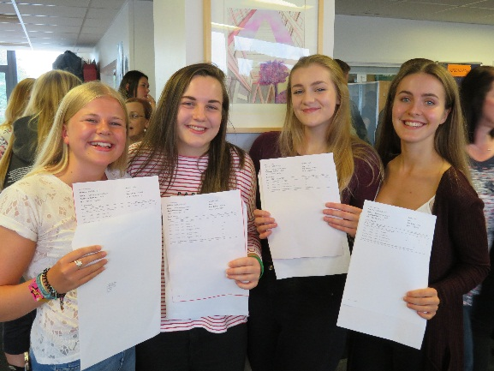
Successful Students
Attendance 95% plus
Punctuality
Follow the dress code
Do homework
Work in non contacts
Show commitment
Organised
Read around the subject
(books, journals,web articles)
Positive member of the school
and wider community
8.40 to 3.10

Slide 10
Sixth Form Culture
“Same students, same standards” as main school
High expectations = high outcomes
Preparing young people for life outside of school.
8 allocated supervised study periods per fortnight – attendance is recorded.
Friday after school detention for poor attendance, punctuality, missed work or failing to adhere to the dress code.

Slide 11
Student Support: Wrap Around Care
Enrichment Programme
Miss Rowlands
Mrs Pass
Mrs Pole
Mr Evans
Subject Teachers
Student
Form Tutor
Mrs Casewell and Careers Staff
Intervention and study support

Slide 12
Intervention To Support Progress
After each Assessment Point
Can Include:
Period 6
Extra Form Tutor Mentoring Sessions
Supervised Study on Thursday Afternoons
Parental Meeting with Mrs Pole/Miss Jardine
Timed essay/exam questions in study periods or after school

Slide 13
Preparing students for life beyond Alsager
The CBI 2018 Education and Skills annual report, Educating for the Modern World, 2 which represents 28,000 employers, found 44% felt young people leaving school, college or university were not work ready.

Slide 14
What are employers looking for?
aptitude and readiness for work
resilience
communication
problem-solving skills
high levels of literacy, numeracy
a rigorous academic foundation.
the ability to take responsibility and make wise choices
leadership skills
strong work ethic: Setting and achieving goals.
dependable: Consistently following through.
positive attitude: Creating a good environment.
self-motivated: working effectively with little direction.
team-oriented: making the most out of collaboration.

Slide 15
As seen in job advertisements
“The ability to prioritise and make effective decisions to ensure deadlines are met”
“Can show examples of working at pace to deliver results in a time sensitive fashion” – Bentley
“Self-motivated and eager to exceed targets/objectives set” – Recruitment Agency
“Team player but able to work off own initiative”
“Flexible and reliable”
“High standards of Health and Safety”
“Follow all company communication standards, procedures, guidelines and policies at all times”

Slide 16
Work Experience and Practical Skills
Time is allocated within the timetable for students to arrange work experience/volunteering.
Part time jobs help develop employability skills.
Leadership within school.
Sports teams and clubs are also an opportunity to show teamwork, commitment and leadership.

Slide 17
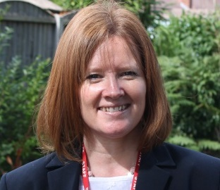
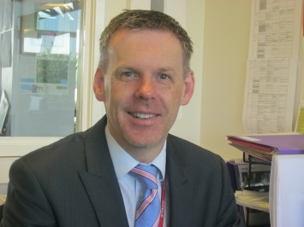
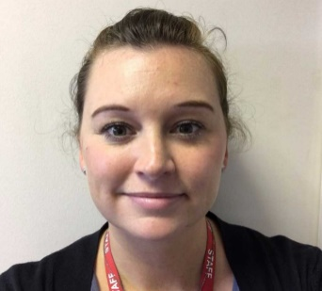
Contacts or Questions
Our Team
Mrs Pole: Director of Sixth Form
Mr Evans: Deputy Director of Sixth Form
Mrs Pass: Student attendance
Post 16 Advice and Guidance Coordinator: – TBC
sixthform@alsagerschool.org
O1270871122
Many thanks for your continued support.

