Slide 2
OUR vision
To create an inclusive community where all are empowered to thrive, hold themselves accountable and achieve the highest standards. Our ethos of kindness and respect is lived and not just talked.

Slide 3
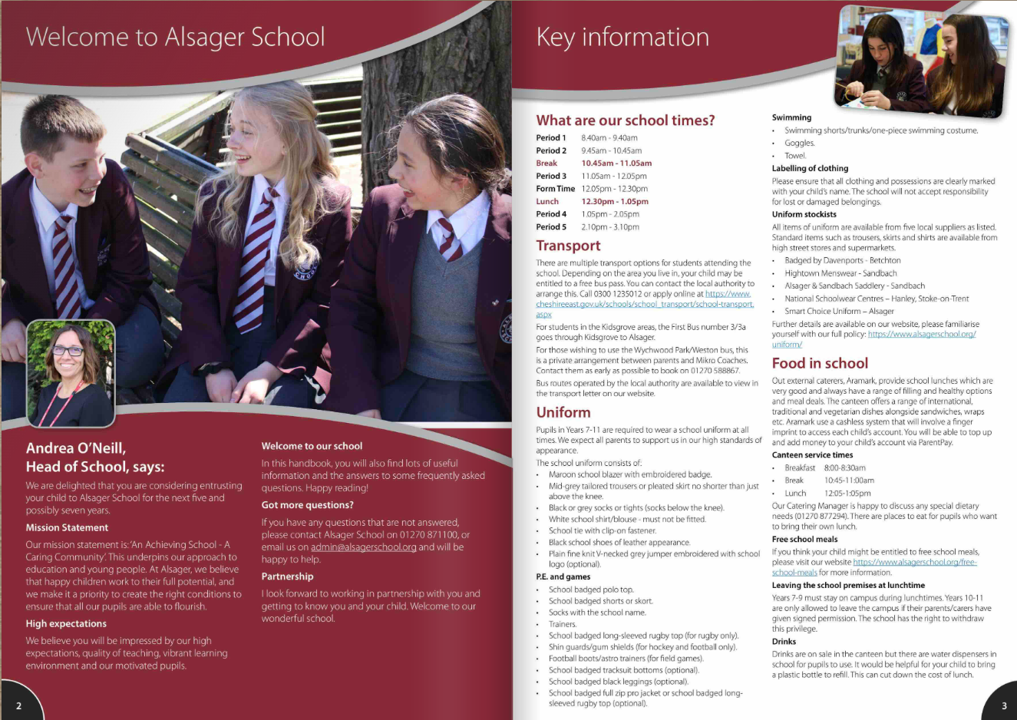
Guide to Parents About Us/Admissions/New Starters

Slide 4
Data Forms

Slide 5
High Standards
School uniform
Behaviour in classrooms –Behaviour for Learning grades (BfL) 1,2,3,4,6,7,8,9
Behaviour around the school - respectful
Behaviour around Alsager
Equipment – prepared for learning
Commitment to learning

Slide 6
School Uniform This is the Alsager Way
‘A Guide For Parents’ details our School Uniform policy for students and where you can find stockists.
Alsager School standards for all students:
Hair for boys and girls
Makeup and nail varnish/fake nails
Piercings
Skirt length
CONDUCT CARD
‘Visible certainty amongst staff and students to allow exceptional behaviour to flourish’

Slide 8
‘The culture is set by the way that the adults behave’ Paul Dix
Pupil relationships and friendships.
Pupil conflict
We are human!
Supporting the school’s standards by demonstrating a ‘united front’ with school.
Standards apply to all children.
Role modelling to children how we as the adults manage conflict and communicate appropriately.

Slide 9
The Alsager Way
‘Visible consistency making everyone feel safe.’
‘The culture is set by the way that the adults behave’
We aspire for the ‘kind of consistency that great parents have. You get the same from each, the same boundaries, the same mantras’.

Slide 10
How will my child be grouped?
College and form allocated using sibling information and information shared at Primary transition meetings
One 30-minute lesson a day
One 1-hour lesson per week (SPIRIT)

Slide 11
How will my child be grouped?
Core Subjects (English, Maths and Science) | Foundation Subjects
Students are put into sets using Key Stage 2 SATs information. | Students are typically taught in mixed ability groups.
Set changes in core subjects
There will be an opportunity based on additional assessments throughout the year to change sets.

Slide 12
Parent Portal
Our Parent Portal is called Insight
Link on the school’s website https://insight.alsagerschool.org/INSIGHT/secure.aspx
Accounts will be created automatically for parents/carers on the first day of school in September and you will receive an email with login instructions.
All kinds of information can be viewed through Insight including, timetables, messages, behaviour, reports, contact details and even what your child has purchased in our canteen for lunch.
We encourage all our parents/carers to login regularly and there is a WebApp available for your convenience.
Contact info-insight or email admin@alsagerschool.org

Slide 13
Reports and Parents’ Evenings
Parents Evenings
Reports and Assessment Points
Year 7 Settling In Evening
October 2023 with the Form Tutors, Mr Pearce and Heads of College.
Year 7 Parents Evening
March 2024 with subject teachers, Mr Pearce and Heads of College.
Assessment Point 1 Report
December 2023
To include information on BfL and attendance
Assessment Point 2 Report
March 2024
To include information on achievement in each subject along with BfL and Attendance
Assessment Point 3 Report
July 2024
As Assessment Point 2

Slide 14
Y6 Induction day Thursday 6th July
Arrive at the front of school for a 9.00am start
Assembly and time with their form tutor
A variety of 3 lessons
15-minute break (bring a drink and snack)
Lunch in Best Bite (Provided free of charge, can bring packed lunch)
Time to relax and play some sport
Music production
2.45pm end of school day at the Leisure Centre courtyard

Slide 15
Wednesday 30th and Thursday 31st August 2023
Confirmation letters have been sent
Further opportunity for your child to work alongside their peers and get to know the school before September
Wide range of activities
Questions should be directed to SummerSchool@AlsagerSchool.org

Slide 16
Contextual Safeguarding

Slide 17
Parents in Partnership

Slide 18
Parents in Partnership
To make a donation, follow the instructions under DONATE, which is on our website mainpage

