Slide 1

Attendance information evening

Slide 2
Meet the Attendance Team
Mr Rob Pearce - SLT Attendance Lead
Mrs Kate Greenwood - Attendance Manager
Miss Penny Cowen - Attendance Administrator

Slide 3
Alsager School Attendance Principles
Missing school means missing out
Students should be at school, on time, ready to learn, every day the school is open, unless the reason for absence is unavoidable
If a student is reluctant to attend, it is never better to cover up the real reason for their absence or to give in to pressure to excuse them from attending
https://www.alsagerschool.org/bfd_download/attendance-policy/

Slide 4
What is good attendance
100%
97%
85%
95%
90%
Our target for all students
6 Days Absence or 30 lessons missed
10 Days Absence or 50 lessons missed
19 Days Absence or 95 lessons missed
29 Days Absence or 145 lessons missed
190 days in each school year
175 non-school days

Slide 5
Persistent Absence
Persistent Absence is classed as any absence that equates to over 10% of the academic year at any given time.
Close of first half-term: 3.5 days in total
Close of 2nd half-term: 7 days in total
Close of 3rd half-term: 10 days in total
Close of 4th half-term: 12.5 days in total
Close of 5th half-term: 15.5 days in total
Close of 6th half-term: 19 days in total

Slide 6
Educational impact Key Stage 4
Pupils who were persistently or severely absent had lower levels of attainment at the end of KS4 than other pupils
Of those pupils who were persistently absent, 35.6% achieved grade 9 to 4 in English and maths. Severely absent (50% absence or more) pupils, this figure was 11.3%. This compares to 83.7% of pupils with no missed sessions and 76.3% who missed between 0 and 5%
Similarly, 16.8% of persistently absent pupils and 5.0% of severely absent pupils achieved grade 9 to 5 in English and maths compared to 66.4% of pupils with no missed sessions and 54.4% who missed between 0 and 5%
https://explore-education-statistics.service.gov.uk/find-statistics/the-link-between-absence-and-attainment-at-ks2-and-ks4

Slide 7
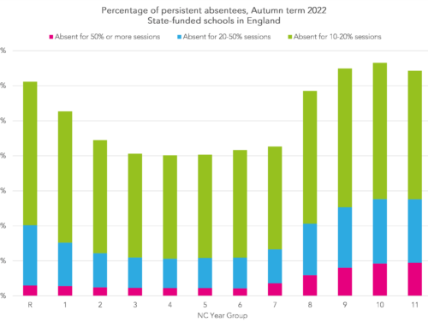
The statistics show that the number of pupils who are persistently absent increase through high school.
Early intervention is essential.
We want to walk alongside you as parents not against you.

Slide 8

Absence patterns
1 day of absence in the first week of summer term
31 days of absence across the academic year
Children missing in education: School best practice webinar 2023
On average any student who is absent for 1 day during the first week of term will end up being absent for 31 days over the academic year

Slide 9
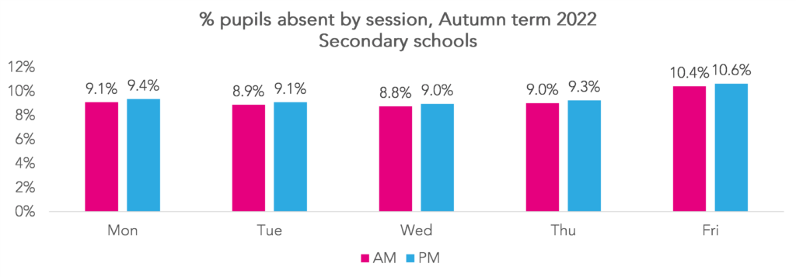
Absence patterns in secondary

Slide 10
Reasons for absence
The two main drivers of higher absence on Fridays than Wednesdays are higher rates of illness and of unauthorised absence.
This appears to be more widespread among severe absentees than the general population, and among pupils who are disadvantaged and/or have an identified SEN.
One of the reasons suggested for pupils missing more school on Fridays than other days was that their parents were more likely to be at home on Fridays. As we’re limited to what’s recorded in the register, we can’t test this.
This pattern wasn’t there before the pandemic.

Slide 11
Reasons for absence
These can be many and varied and every child is different and has their own reasons-working together and sharing these reasons are essential.
Pupils are too ill to attend
Parents did not have a good experience of school themselves and do not see the importance of attendance
Attendance data may be misunderstood by parents – while 90% may be good as a mark in a test, in attendance terms it means one day a fortnight being missed
Routines may not in place at home, leading to lateness, which can lead to non-attendance through embarrassment or frustration
Parents cannot get their secondary-age children to come to school, even though they understand the importance of attendance
Older pupils’ non-attendance is affecting their younger siblings – the whole family stops attending
The pupil is a young carer
There are financial barriers, for example parents being unable to afford transport to school or school uniform
Pupils are anxious about attending school
Pupils have fallen out with other pupils, sometimes on social media, and do not want to encounter them while at school so make excuses to avoid school

Slide 12
Pupils with SEN or Medical conditions
Some pupils face greater barriers to attendance than their peers.
These can include pupils who suffer from long term medical conditions or who have special educational needs and disabilities.
Their right to an education is the same as any other pupil and therefore the attendance ambition for these pupils is the same as it is for any other pupil.
We will work with their parents and put additional support in place where necessary to help them access their full-time education

Slide 13
What can school do to support
There is lots of support for pupils once they are in school- work closely with HoC/SEN team/Form tutor
Family liaison officer- Sara Leopold
Attendance team and Local Authority Attendance team
Work with pupils and parents to understand any barriers and overcome them

Slide 14
What can parents do to support?
Have a copy of the timetable on display
Help pupils to pack their bag the night before- check their organiser
Have a regular routine with regards homework or encourage them to come to homework club
Email or encourage them to speak to teachers if they are having difficulty in lessons
Email or encourage them to speak to their HoC or form tutor if they are having difficulty with social issues
Speak positively about school. Ask them about the best parts of their day

Slide 15
What can parents do to support?
Reward them for success at school
Give them time to decompress at the end of the school day
Good sleep pattern-set routine
Work with the school to help us understand and overcome any barriers
Remind them that everyone must come to school, it is not a choice
Discussion about the importance of attendance and why education is valuable for them

Slide 16
Always make school a priority
Please don’t make a doctor, dentist or optician appointment during school time unless this is absolutely necessary.
If you do need to make an appointment in school time, try to ensure that your child misses as little of school as possible.
We know that travel companies don’t make it easy for families but please don’t book a holiday during term time (it won’t be authorised, your child will fall behind and you may be fined).

Slide 17
Always make school a priority
Please don’t allow your child to stay off school to make things easier for yourself – this is against the law.
Please don’t allow your child to miss school on Mondays and Fridays if you are going away for the weekend.
Please don’t allow your child to take a day off because of the weather or they had a bad night.
Please don’t allow your child to take a day off for their birthday or other special occasions. This does not prepare them for adult life.

Slide 18
What are the positives for your child?
(Y8 B.C.) Alsager school is a great school that allows you to be yourself and helps you to grow and be independent.
(Y9 C.C.) I really like learning in school and developing my knowledge. I am motivated to do this because learning and developing skills throughout my childhood will significantly help me as an adult when I strive for careers and jobs that will make me happy in the future. Ultimately, by doing this I will be motivated to get up for work in the future, as I’ll enjoy my job.
(Y10 O.W.) School is fun and I feel safe. Teachers are nice and I like homework club.
(Y12 C.S.) I’ve made life-long friends in school and the teachers are really supportive.

Slide 19
What are the positives for your child?
(Y8 A.H.) Seeing my friends, doing my favourite subjects, seeing different teachers, taking part in challenges, taking part in different activities held in school, learning new things, celebrating achievements in the celebration assembly.
(Y9 H.C.) I enjoy learning in lessons and expanding my knowledge and I don’t like being behind in lessons which compels me to come into school as much as possible. If you miss one lesson, you could miss one important topic which will have an impact on assessments.
(Y7 T.M.) I really enjoyed SPIRIT week, we got to do loads of different things that I didn’t expect us to do in school.

Slide 20
Sharing information and working together
Please work with us and share information about your child with the attendance team or your child's HoC.
If we don’t know we can’t offer support.
If you are not already aware, establish what the barriers are and what are the positives for your child.
If you are unsure or need help, please get in touch.

